Slide 1

Eatery Management System
COMP3900 - W18AZEAL
Final Demo

Slide 2

Agenda
Project Overview / Introduction
01
Frontend: Restaurant Platform
02
Frontend: Customer Platform 1
03
Frontend: Customer Platform 2
04
Backend / GitHub Set up
05

Slide 3
Project Overview
Fully Completed
As planned
On schedule
Progress check and meetings throughout the development cycle
Features developed according to the proposal

Slide 4
System Introduction
Eatery system
Providing vouchers for discounts
Use in restaurant
Providing opportunities for advertisements
Attract more customers

Slide 5
Eight Functionalities
6 Basic Functionalities
1. Account Management
2. Search Bar
3. Voucher Releasing
4. Voucher Redeeming
5. Voucher Sharing
6. Voucher Overview
2 Novelty Functionalities
7*. Menu Configuration
8*. Rating / Review System

Slide 6

Account Management
Create account
Sign in
Sign out
Reset password
Change personal information

Slide 7
Search Bar
Search using keywords
Variety of information
Can be sorted

Slide 8
Voucher Releasing
Voucher 1: Percentage Discount
Voucher 2: Buy 1 get 1 free
Voucher 3: Discount after certain spent
Voucher 4: Free food voucher
Allows further configurations
Auto voucher releasing

Slide 9
Voucher Redeeming
Collect vouchers
Converting into 4-digit code
Codes contain random capital letters and numbers
Expire countdown

Slide 10
Voucher Sharing
Social feature
Share vouchers to other users
Provide email address
Receivers cannot collect the same voucher again

Slide 11

Voucher Overview
Show all used vouchers
Show all unused vouchers
Important reference

Slide 12
Menu Configuration
Upload unique menu
1
Add name of the dish
2
Add picture of the dish
3
Add brief description
4

Slide 13
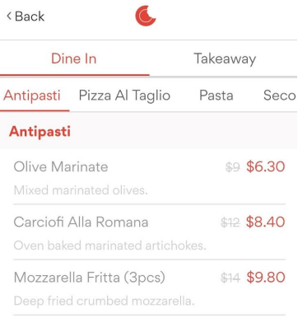
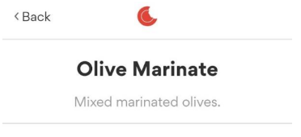
Eat Club: Insufficient Menu Information

Slide 14
Review / Rating
Rate out of 5
Review
One rating associated with each review
Reply
Report certain comment
Comment will be taken down if reported too many times

Slide 15
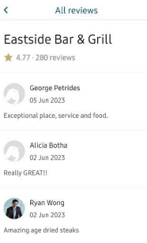
Frist Table: No rating associated with review, can’t reply

Slide 16
Summary
Customer Platform
(2 members)
Restaurant Platform
(2 members)
Backend Development
(1 member)

Slide 17
2. Frontend Demonstration

Slide 18
3. Backend/GitHub Setup

Slide 19
Main Structure
Python Flask Structure for Development
Models: Stores database models
Services: Stores all logics
Routes: Stores all routes

Slide 20
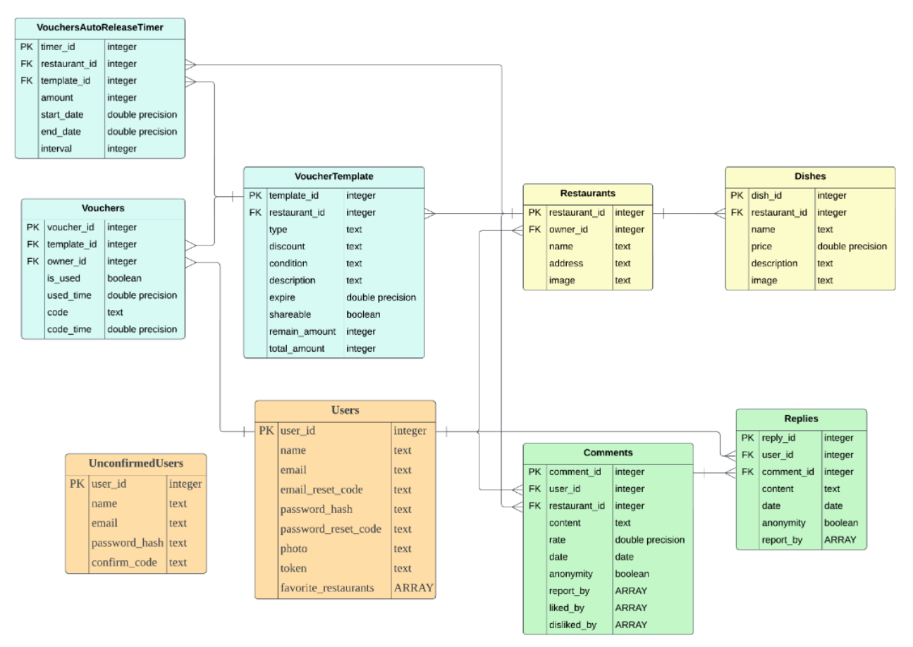
Models
ER Diagram
Relations formed by external keys
Effectively reduces redundancy

Slide 21
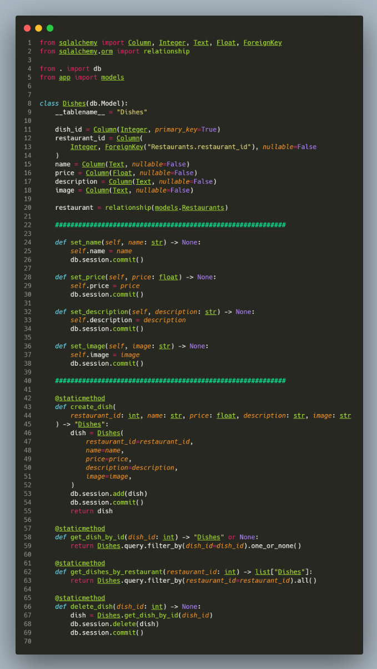
Object-relational Mapping

Slide 22
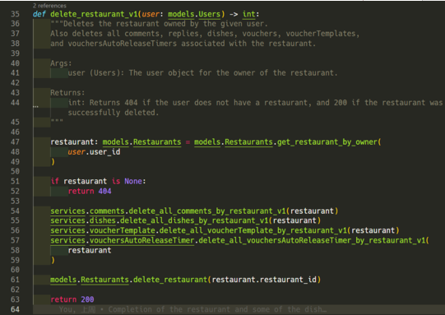
Services

Slide 23
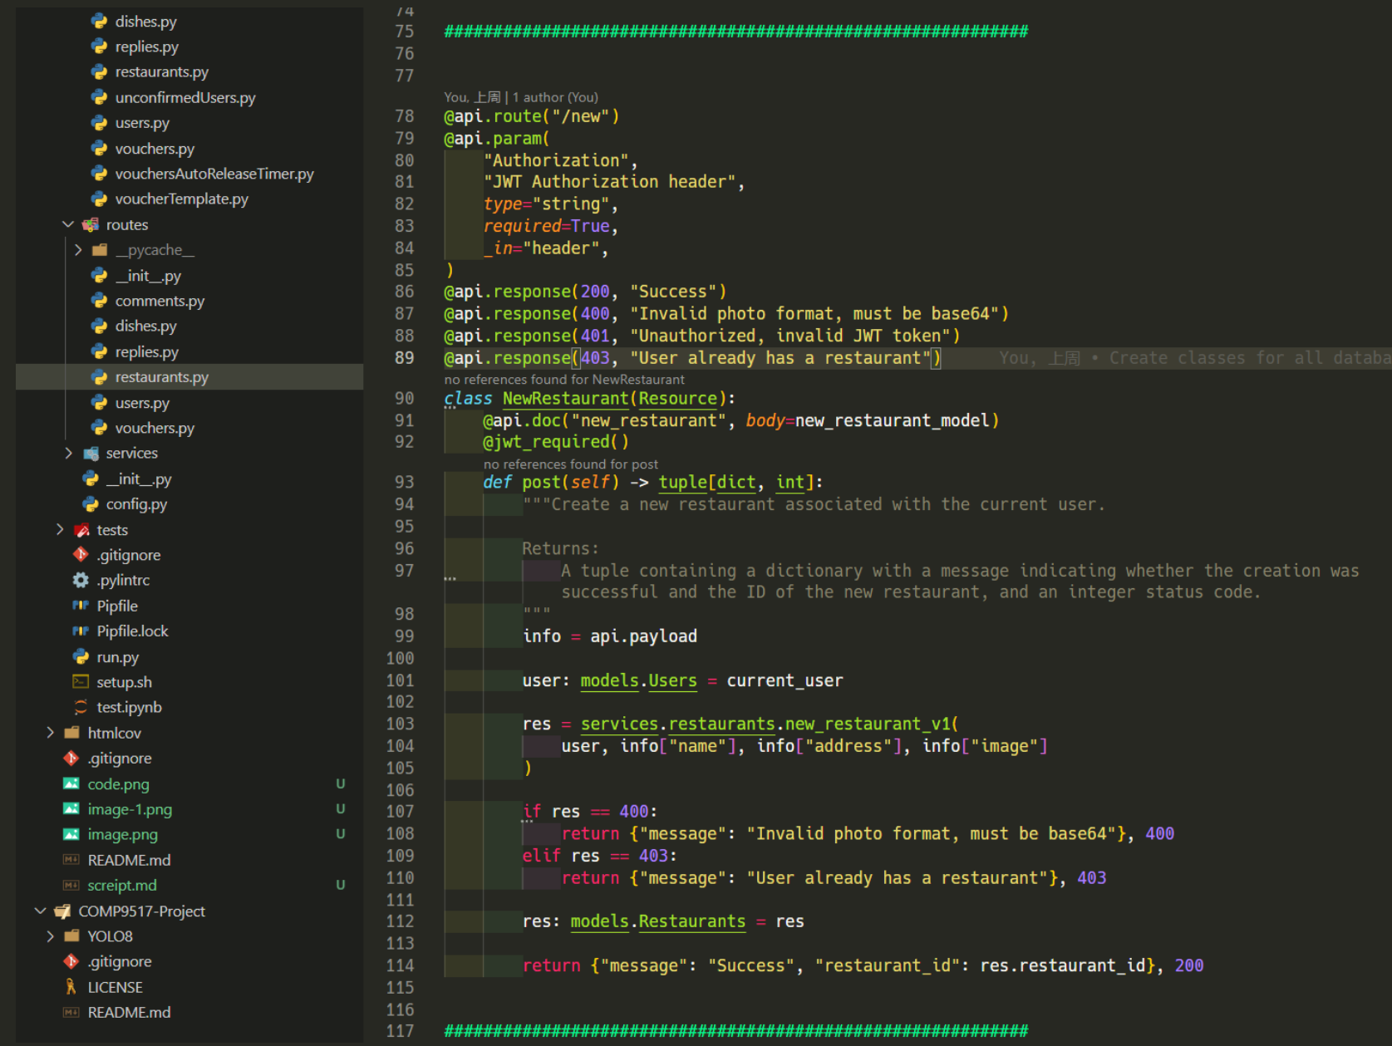
Routes
Easy to maintain
Clear

Slide 24
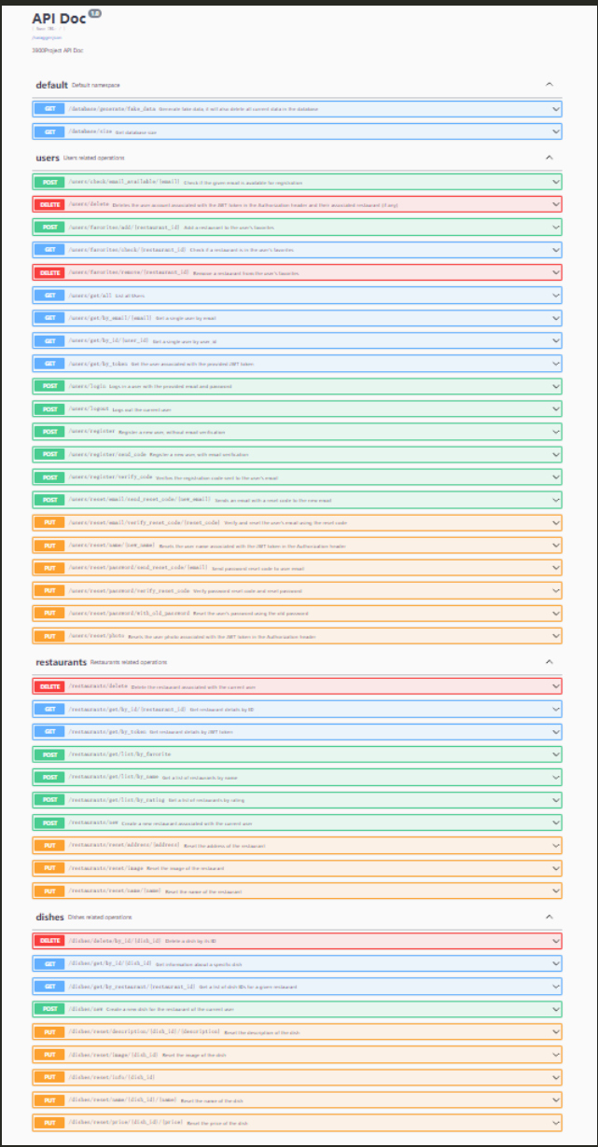
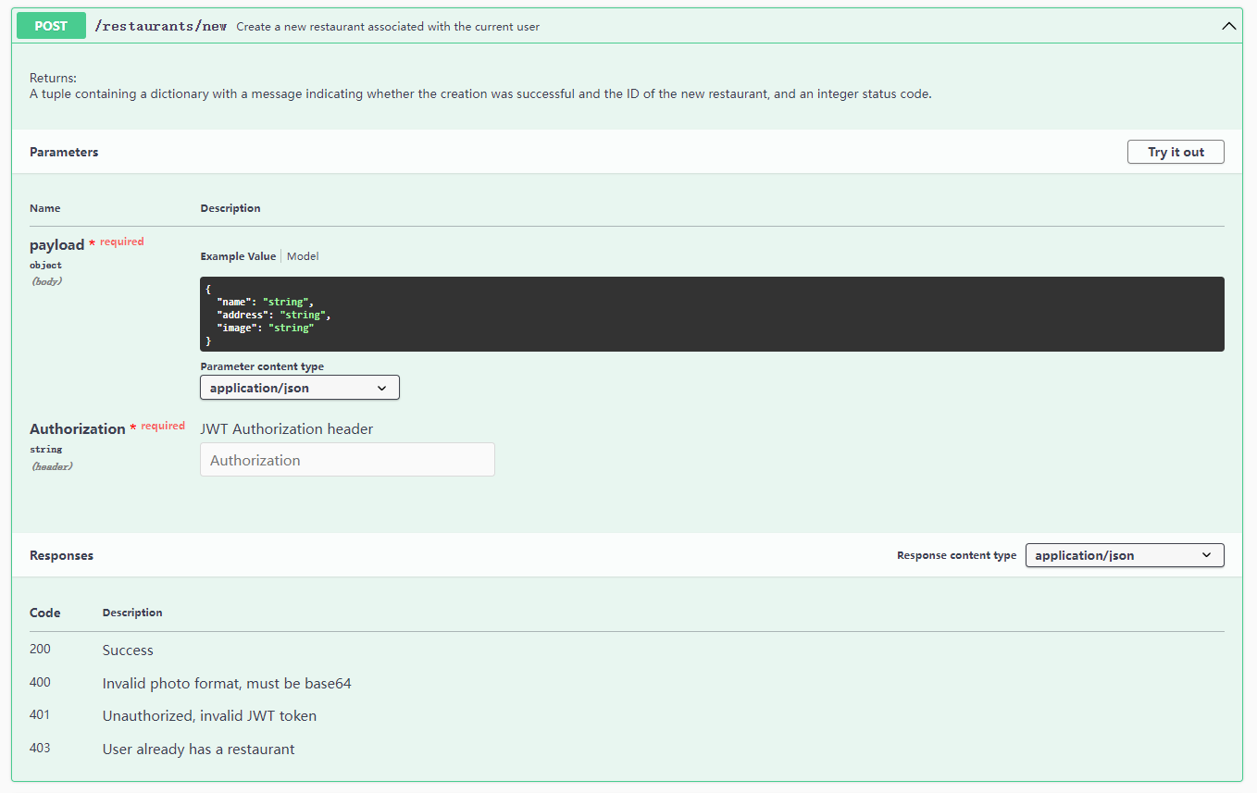
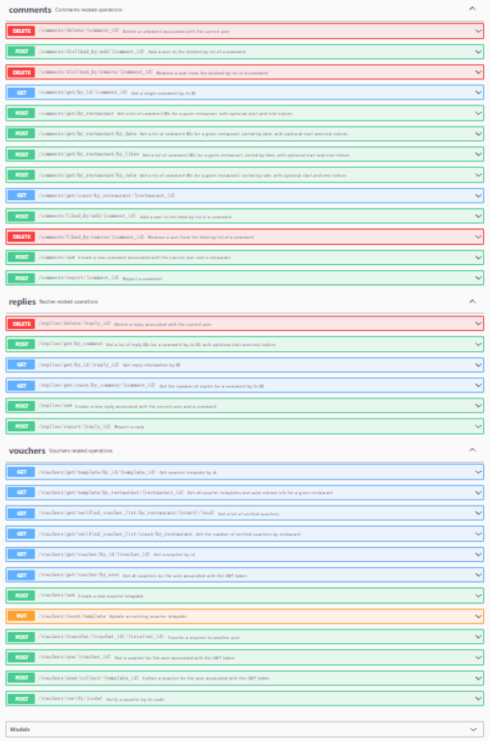
API DOC

Slide 25
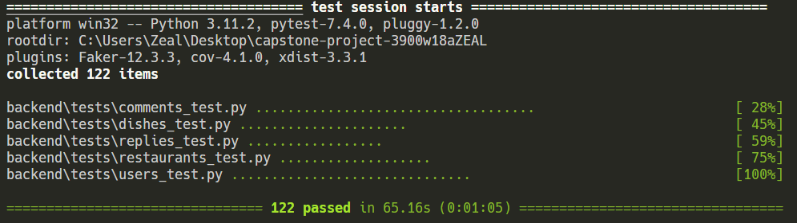
Testing

Slide 26
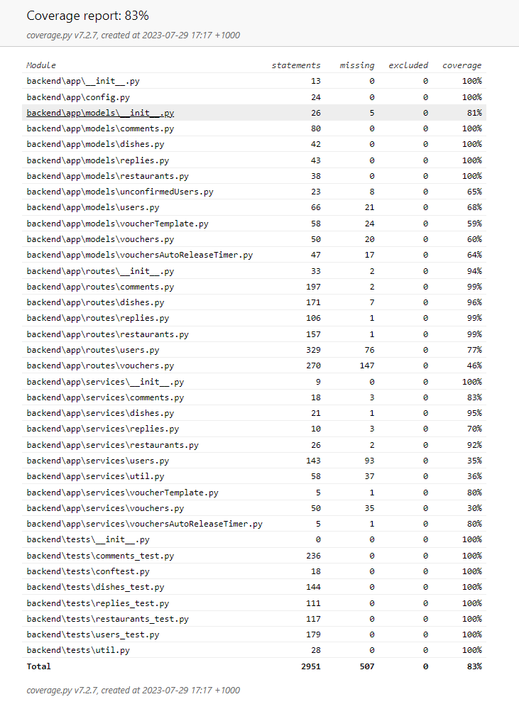
Coverage

Slide 27
End of Presentation

